Slide 1
Predicting future price of Nifty Fifty using time series models
Completed
A guide on stock market analysis!

Slide 2
Why is stock market prediction essential?
Stock market prediction is primarily done to technically analyze future prices and to identify how they can vary, so that investors can make informed decisions.​
Although technical analysis does not result in absolute predictions, it can help investors anticipate what is "likely" to happen to prices over time.​
It is applicable to stocks, indices or any tradable instrument where the price is influenced by the forces of supply and demand.​
Mostly beneficial for the company's expansion, investor's growth and it's impact on the country.

Slide 3
Tying it up!
The Secret Recipe for Success in Stock Market is simple.
30% in MARKET ANALYSIS SKILLS,
30% in RISKS MANAGEMENT,
30% in EMOTION CONTROL,
And 10% in LUCK .
- Benjamin Lee

Slide 4


Which company should SRK choose?
SRK wants to sponsor the IPL team, Kolkata Knight Riders.
He is in short of funding and hence would like to choose a company, that has potential growth and invest, in order to gain enough returns.
Which company must he invest in? Reliance or Airtel?
Insert images if required here:
And let it just occupy this much space!
Insert images if required here:
And let it just occupy this much space!

Slide 5
Join the battle..
reliance | AIRTEL
Largest private sector company in India, established by Dhirubhai Ambani. | Leading global telecommunication company, established by Sunil Mittal.
Headquartered in Mumbai, India. | Headquartered in New Delhi, India.
Owns businesses engaged in telecom, energy, petrochemicals, textiles, retail and natural resources. | Product offerings include 2G, 3G and 4G wireless services, mobile commerce, fixed line, broadband and many more.

Slide 6


Elemental !
Reliance Jio's total broadband subscriber base stood at 432.96 million in November. It was followed by Bharti Airtel with 210.10 million broadband customers
Airtel's ARPU is the highest in the industry at Rs 146. In comparison, Jio's ARPU is at Rs 138.4
Reliance Jio (Jio) and Bharti Airtel will grab 47% and 31% revenue market share respectively by 2025

Slide 7
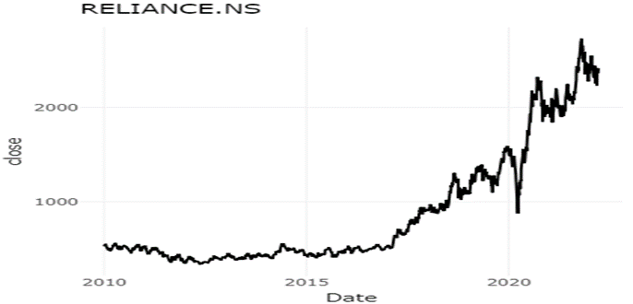
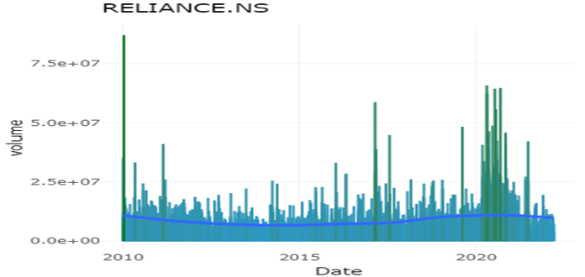
The Success story of Reliance
•The best period of performance has been the 2015-2020, when the stock has given positive returns each year. This has been achieved in spite of the major stock market crash due to Covid in March 2020.
•If you are a long term investor, you cannot expect exceptional performance every year. A few years of good performance, will be followed by price corrections.

Slide 8
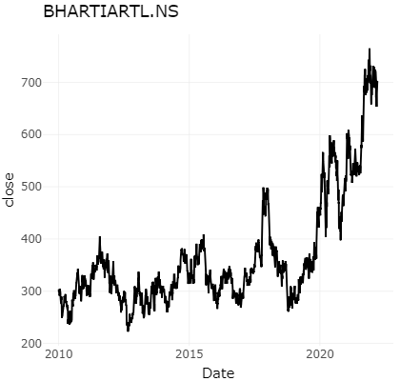
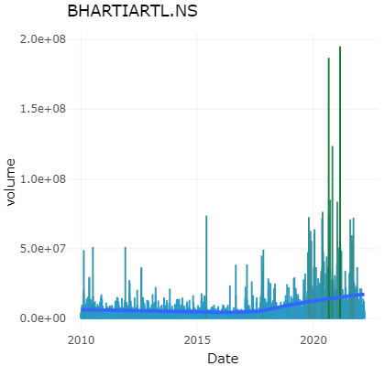
The consistency of Airtel !
•Bharti Airtel is a leading telecom company operating in South Asia and Africa. "Work from Home" culture due to pandemic was a boon to the Indian Telecom sector.
• Customers wanted to shift to 4G from 2G provider which ended up taking Jio’s offer which was relatively cheap, hence airtel lost its potential customers.
• If you are an investor or plan to invest in Bharti Airtel, you must look at it as a long term play for at least 5-10 year horizon.
Insert images if required here:
And let it just occupy this much space!
Insert images if required here:
And let it just occupy this much space!

Slide 9
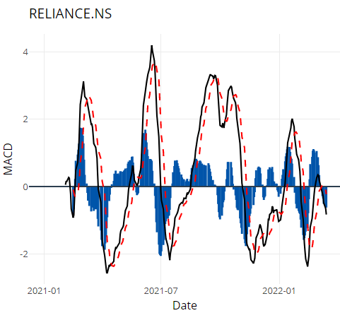
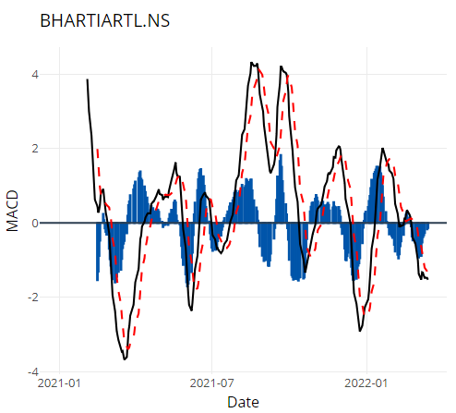
Technical Analysis - MACD
Moving average convergence divergence (MACD) is a trend-following momentum indicator that shows the relationship between two moving averages of a security’s price.
The MACD is calculated by subtracting the 26-period exponential moving average (EMA) from the 12-period EMA.
MACD is often displayed with a histogram which graphs the distance between the MACD and its signal line.
The MACD plot for both Reliance and Airtel

Slide 10
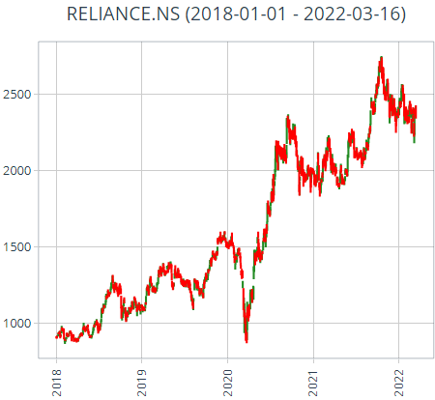
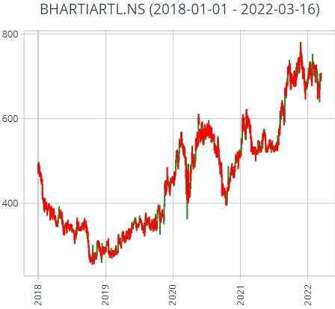
Technical Analysis - CandleStick Chart
Candlesticks are useful when trading as they show four price points (open, close, high, and low) throughout the period of time the trader specifies.
What will be the open and close on a weekly Candlestick chart?
If the open will be Monday's first trade then the close will be automatically Friday's 3:00 to 3:30 pm. And the High will be the High of the week and the Low will be the Low of the week.
Candle Stick chart of both Reliance and Bharti Airtel shows an upward trend with a little sideways trend in 2022.

Slide 11
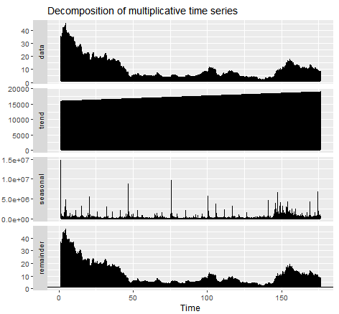
Decomposition of Time Series Data
Decomposition is primarily used for time series analysis, and as an analysis tool it can be used to inform forecasting models on your problem.
The Additive and Multiplicative decompositions are described for a time series with a seasonal period m
The decomposition plot shows where the trend-cycle is more flexible, the seasonal component does not change over time, and the robust option has been used.

Slide 12
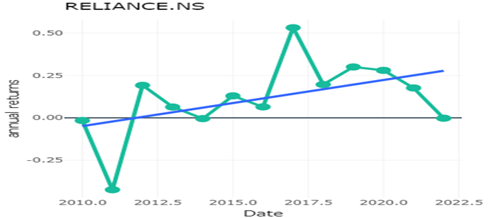
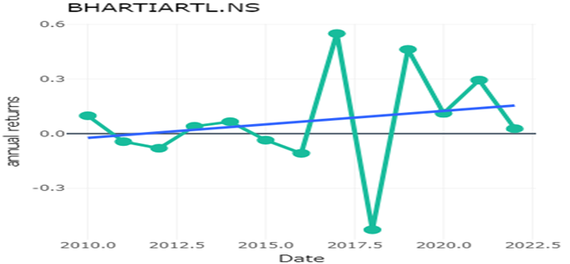
Annual Returns
•Airtel comparatively maintains stable growth
•RIL’s $21 billion investment in Jio over the last six years has hobbled the stock performance.
•Based on our forecasts, a long-term increase is expected, the "Reliance Industries Ltd" stock price prognosis for 2027-03-05 is 4487.750 INR.
Insert images if required here:
And let it just occupy this much space!
Insert images if required here:
And let it just occupy this much space!

Slide 13
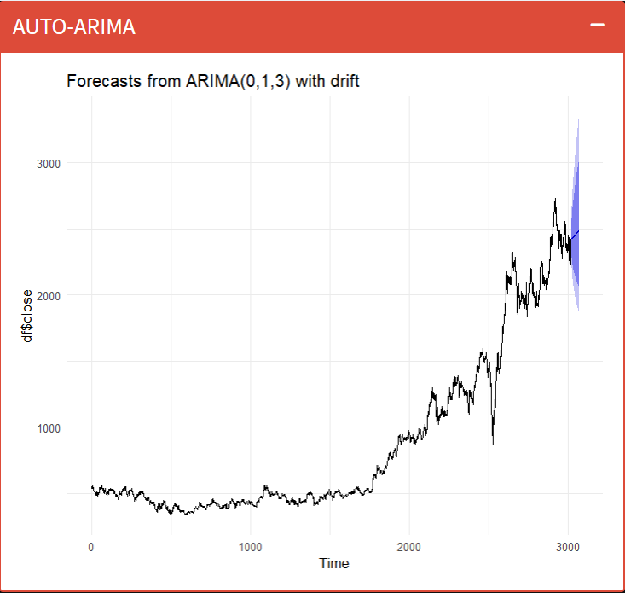
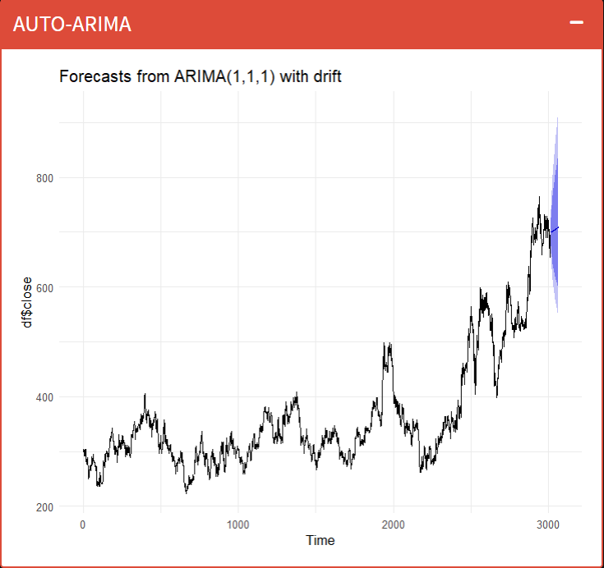
Arima and point forecast price
Auto-Regressive Integrated Moving Average (ARIMA) model for forecasting time-series data is to use the previous and present data to predict the future.
ARIMA models is generally denoted by ARIMA(p,d,q) where p, d, and q are the parameters with positive values.
The auto-arima plots for both bharti airtel and reliance shows an increasing trend in forecasted stock price with minor ups and downs.
The point forecasts for each day is shown on the app.
Reliance
Airtel

Slide 14
What is the significance of ADF test?
Performs the Augmented Dickey-Fuller test for the null hypothesis of a unit root of a univariate time series x (equivalently, x is a non-stationary time series)
If the p-value is > 0.05, then the time series is not stationary and use differencing to make it stationary
#​ | Company Name | Is Stationary | P- value | Description
1. | ​Reliance | No ​ | ​0.5253 | p-value > 0.05 time series is not stationary
2. ​ | Bharti Airtel | No ​ | ​0.7525 | p-value > 0.05 time series is not stationary

Slide 15
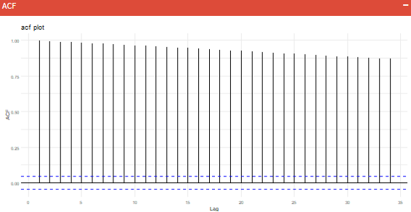
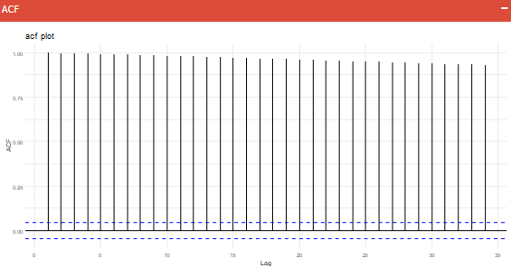
ACF plot
A plot of the autocorrelation of a time series by lag is called the AutoCorrelation Function, or the acronym ACF. It is called a correlogram or an autocorrelation plot.
Because the correlation of the time series observations is calculated with values of the same series at previous times, this is called a serial correlation, or an autocorrelation.
It is used to give the order of AR component, p.
The order of p for Reliance and Airtel is 0, as shown by ACF plots.
Airtel
Reliance

Slide 16
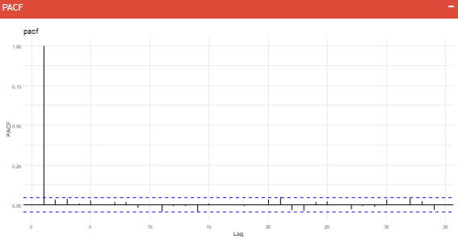
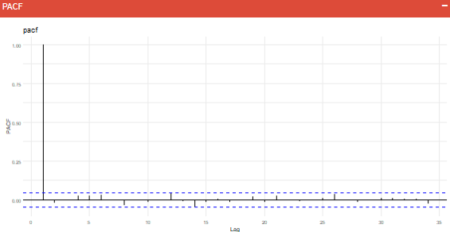
PACF plot
A partial autocorrelation used for relationship between an observation in a time series with observations at prior time steps with the relationships of intervening observations removed.
It is used to give the order of MA component, q.
The order of q for Reliance and Airtel is 1, as shown by PACF plots.
Airtel
Reliance

Slide 17
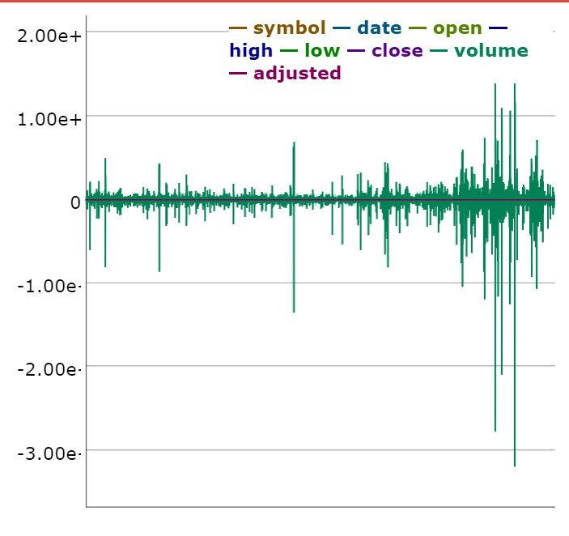
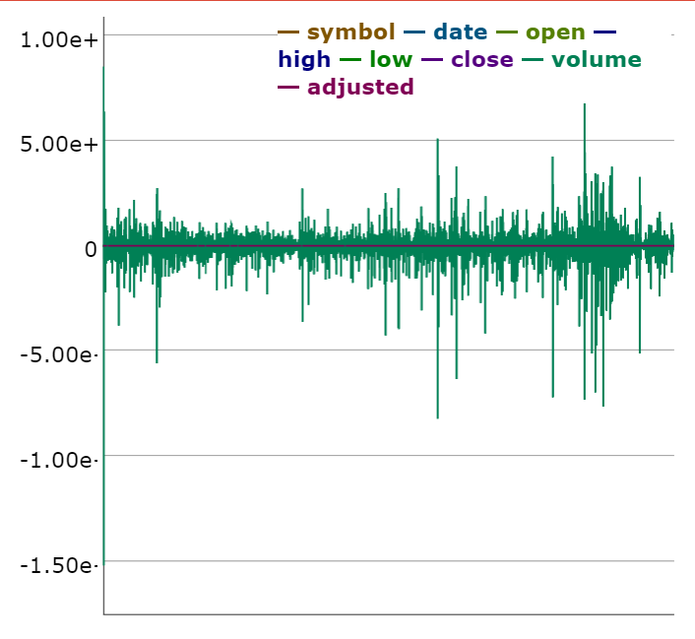
What is Stationarity in Time Series?
One of the common assumptions in many time series forecasting techniques is that the time series being used is stationary.
In a stationary time series the mean, variance and autocorrelation structure is a constant and does not change over time.
A stationary time series looks flat without any trend component.
A stationary time series also does not exhibit any periodic or seasonal fluctuations.
Bharati Airtel
Reliance

Slide 18
How to convert a Non-Stationary Time Series into a Stationary Time Series?
We can difference the data. Given a time series Zt we can create a new time series Yt=Zt - Z(t-1). Although we can difference the data more than once, one difference is usually sufficient.
If the data contains a trend we can fit some type of curve to the data and then model the residuals from that fit. Since the purpose of the fit is simply to remove long term trend, a simple fit like a straight line can be used.
For non-constant variance in a time series, taking the logarithm or square root of the series many stabilize the variance.
Sometimes logarithmic differencing also satisfies the purpose.

Slide 19
Box Ljung Test
This test is a way to test for absence of serial autocorrelation between the residuals up to a specified lag 'k'. Essentially Box Ljung test is a test to check lack of fit.
Null hypothesis(H0) : Model does not show significant lack of fit (autocorrelation of the residuals is very small).
Alternate hypothesis(HA) : Model does show a significant lack of fit (autocorrelations of the residuals are significantly high).
#​ | Company Name | D.O.F | P- value | Description
1. | ​Reliance | 3 ​ | ​0.5253 | p-value > 0.05 time series is not autocorrelated
2. ​ | Bharti Airtel | 3 ​ | ​0.9987 | p-value > 0.05 time series is not autocorrelated

Slide 20
Prophet Model
Prophet model is a time series forecasting tool developed by Facebook.
The Prophet model uses a decomposable time series model with three model components being trend, seasonality and holidays.
The three components are combined in the following equation
y(t) = g(t) + s(t) + h(t) + e
Here g(t) is the trend function which models non-periodic changes, s(t) represents periodic changes(daily, weekly, yearly,) and h(t) represents the holiday effects.
'e' is the error component which is not accommodated by the model.

Slide 21
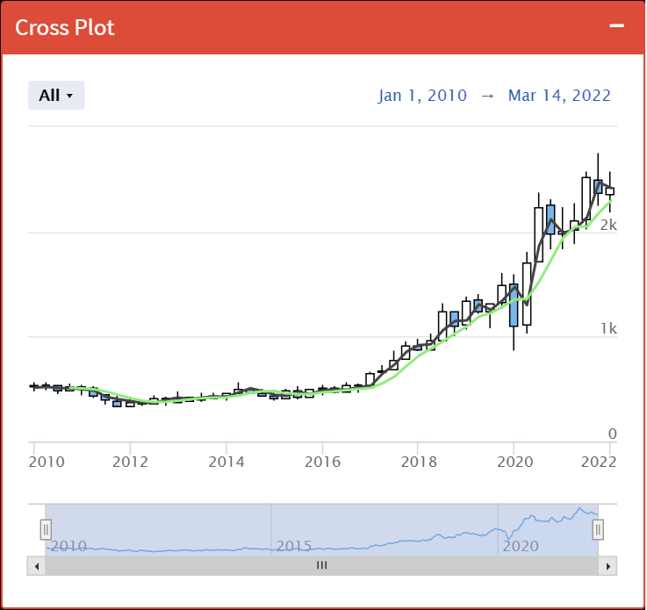
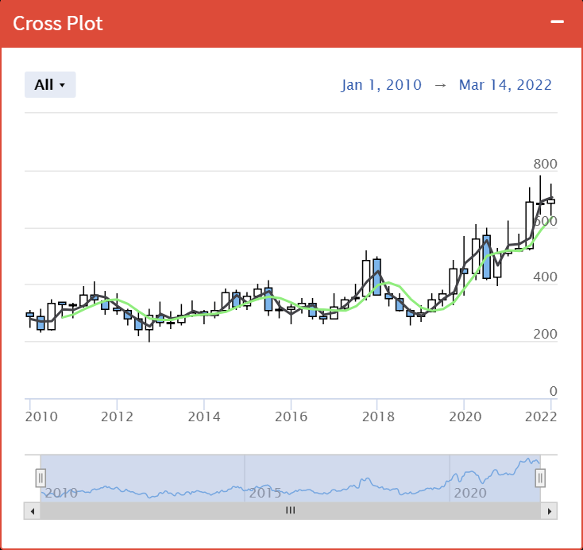
Trading Strategies - Golden Cross
A golden cross is a technical chart pattern indicating the potential for a major breakout.
The golden cross appears on a chart when a stock's short-term MA crosses above it's long-term MA.
There is no potential crossover between Reliance and Airtel stocks, indicating no potential breakouts in the future stock prices.
Insert images if required here:
And let it just occupy this much space!
Reliance
Insert images if required here:
And let it just occupy this much space!
Airtel

Slide 22
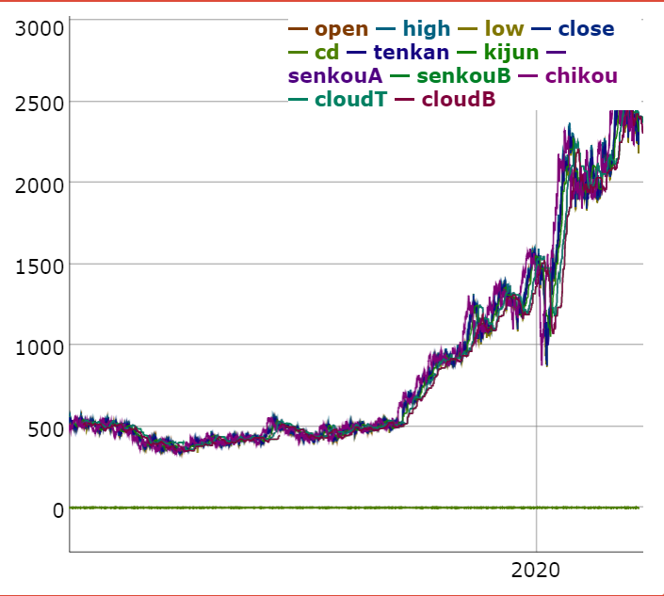
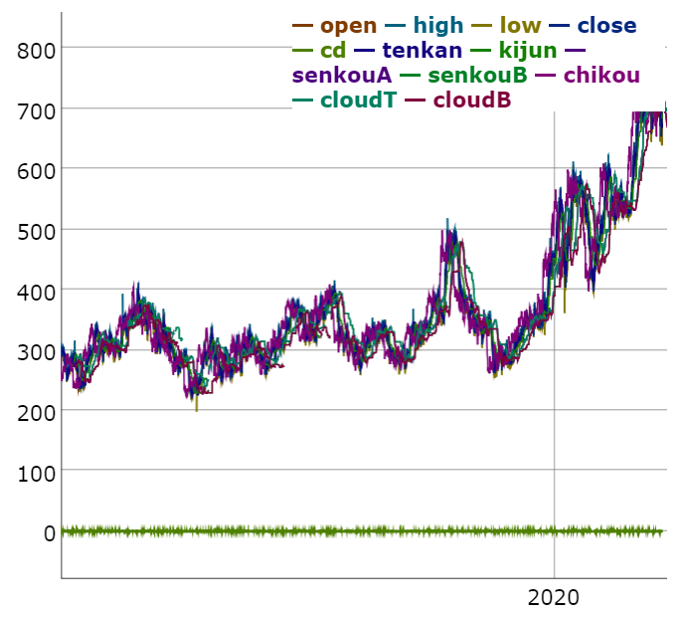
Trading strategies - Ichimoku
In Japanese, Ichimoku translates to one look. The traders just have to take a single look at the chart to determine how the price varies.
There are five indicators in total .i.e., Tenkan, Kijun, Senkou A, Senkou B and Chiku Span.
Even though there are lot of fluctuations in between, it still shows increasing long term trend. This indicates that the users should invest long term to gain profits.
Insert images if required here:
And let it just occupy this much space!
Reliance
Insert images if required here:
And let it just occupy this much space!
Airtel

Slide 23
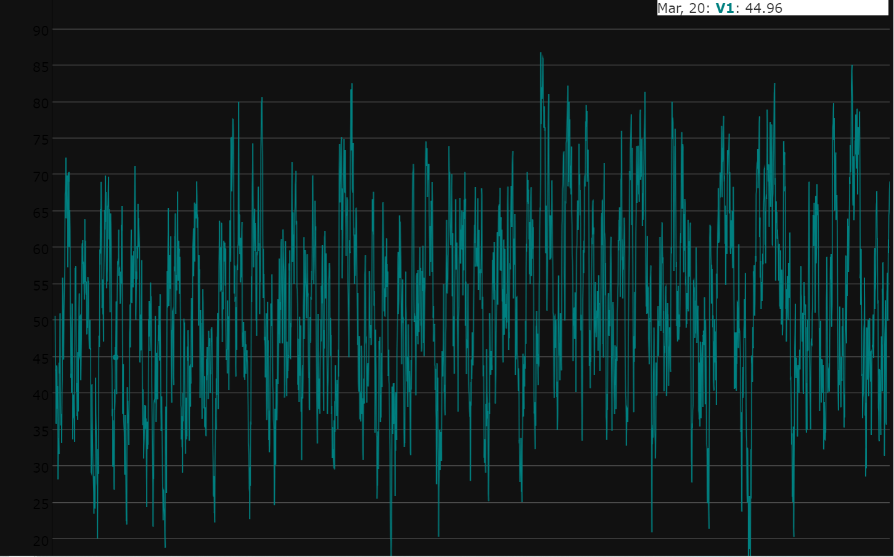
Relative Strength Index
The Relative Strength Index is a momentum indicator that evaluates overbought or oversold conditions by measuring the magnitude of recent price changes for various assets.
When the RSI surpasses the horizontal 30 reference level, it is a bullish sign and when it slides below the horizontal 70 reference level, it is a bearish sign.

Slide 24
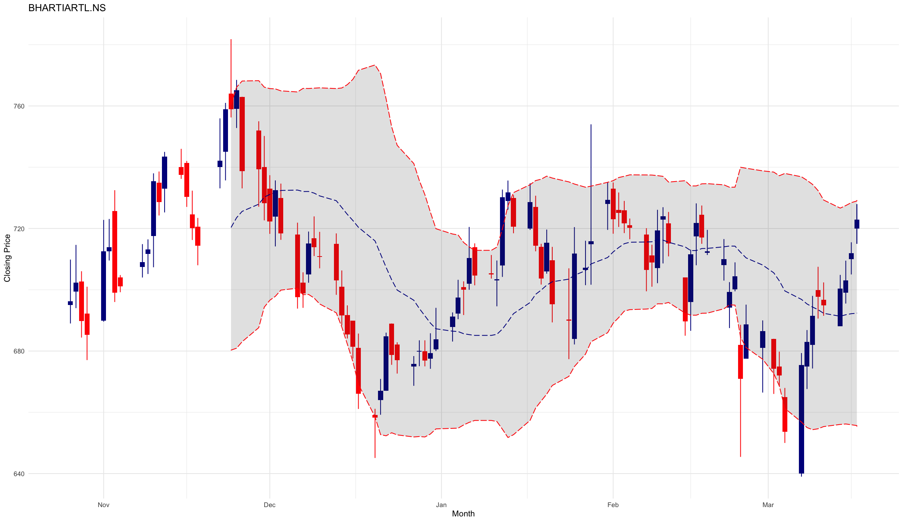
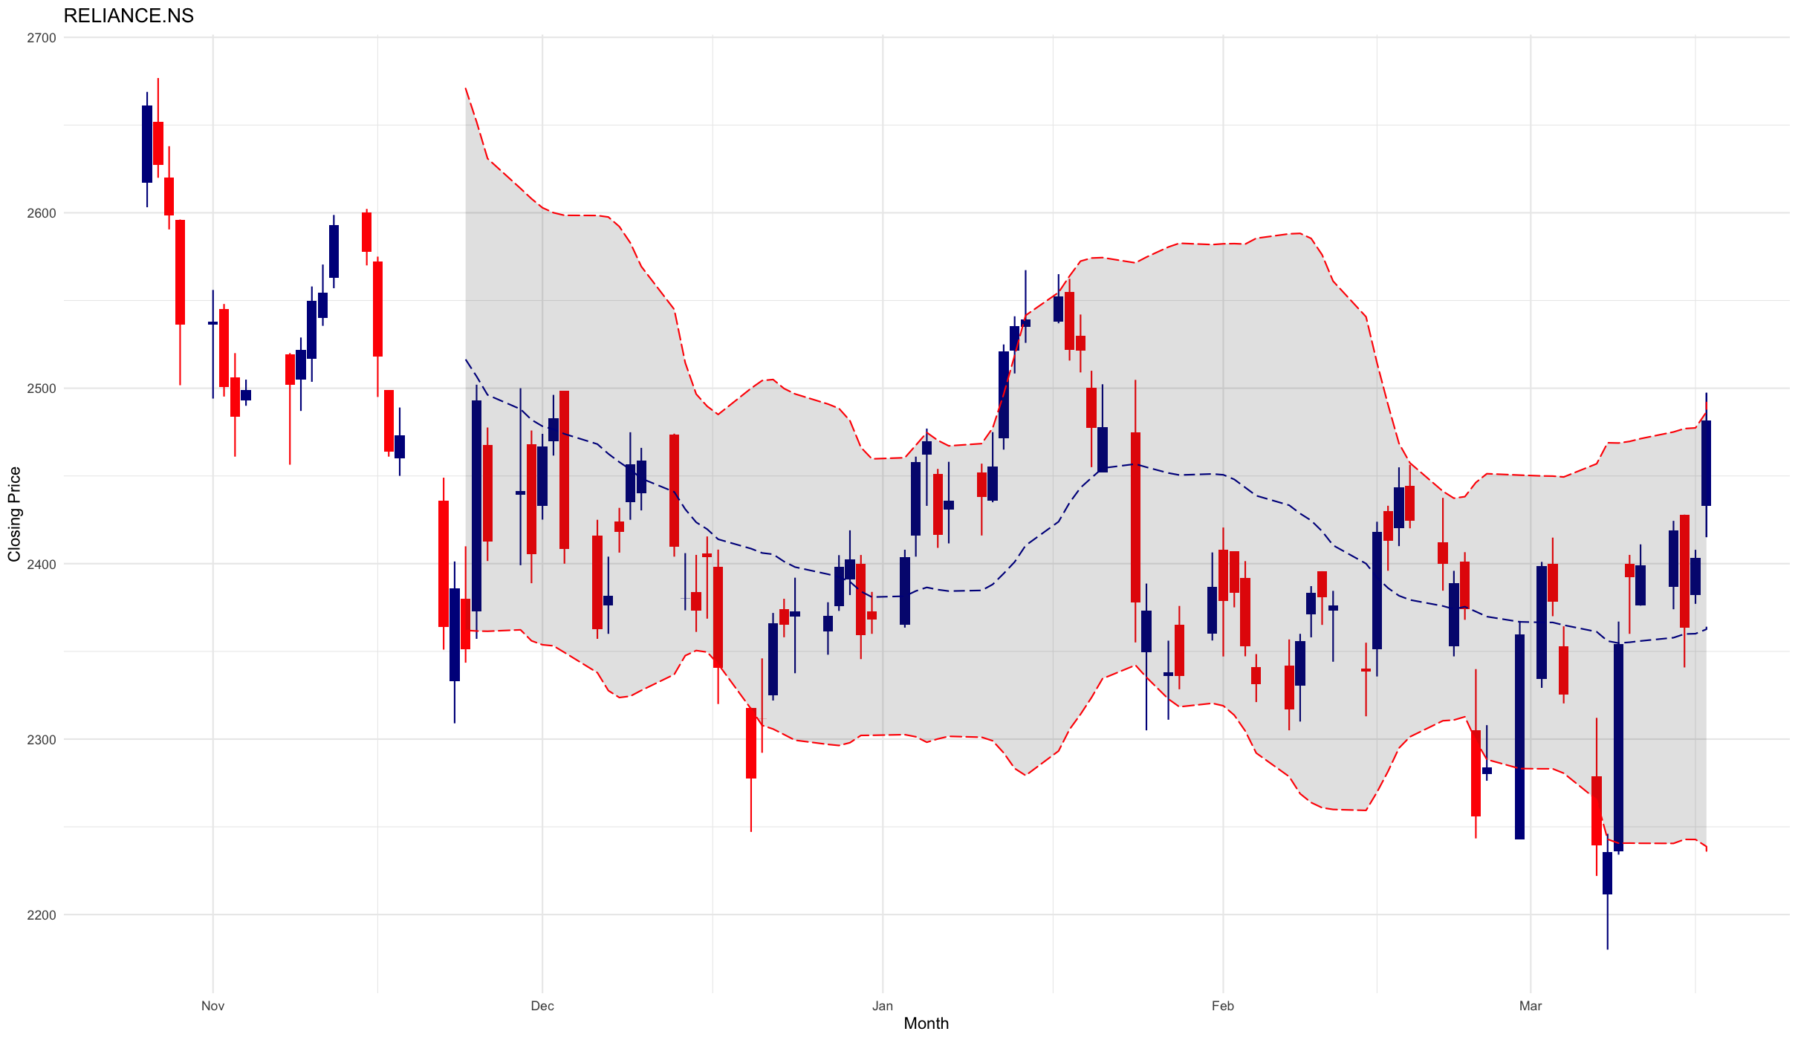
Bollinger Bands
A Bollinger Band is a technical analysis tool defined by a set of trendlines plotted two standard deviations (positively and negatively) away from a simple moving average (SMA) of a security's price, but which can be adjusted to user preferences.
When stock prices continually touch the upper Bollinger Band, the prices are thought to be overbought; conversely, when they continually touch the lower band, prices are thought to be oversold, triggering a buy signal.
When using Bollinger Bands, designate the upper and lower bands as price targets.
Insert images if required here:
And let it just occupy this much space!
Insert images if required here:
And let it just occupy this much space!

Slide 25

Why Stock-ers?
Since Airtel is performing consistently, and if SRK is not ready to take up the risk, then, he can invest in Airtel. Airtel being the best in telecom industry.
Reliance has a steady growth, it has faced downfalls in the past. It has the potential to generate high revenue and bring in huge profits. If SRK can afford to take that risk, he can most certainly invest in Jio.
We use real time data – shows the updated price or volume information on a tick-by-tick or minute-by-minute basis for stock that trades on the exchange.
Separate tabs for Laymen, Statisticians – Interactive graphs, point estimates for about 90 days

Slide 26


Potential Improvements!
It takes time for the graphs to load – This can be resolved using various optimization methods.
Clubbing multiple graphs together – Example: Candle-Stick Chart
The front end part of it could have been more attractive – Using JavaScript components.
News section for news grabbers.

